Slide 1
The best little grant workshop in Arkansas, or:
How I learned to stop worrying and love the red tape.

Slide 2
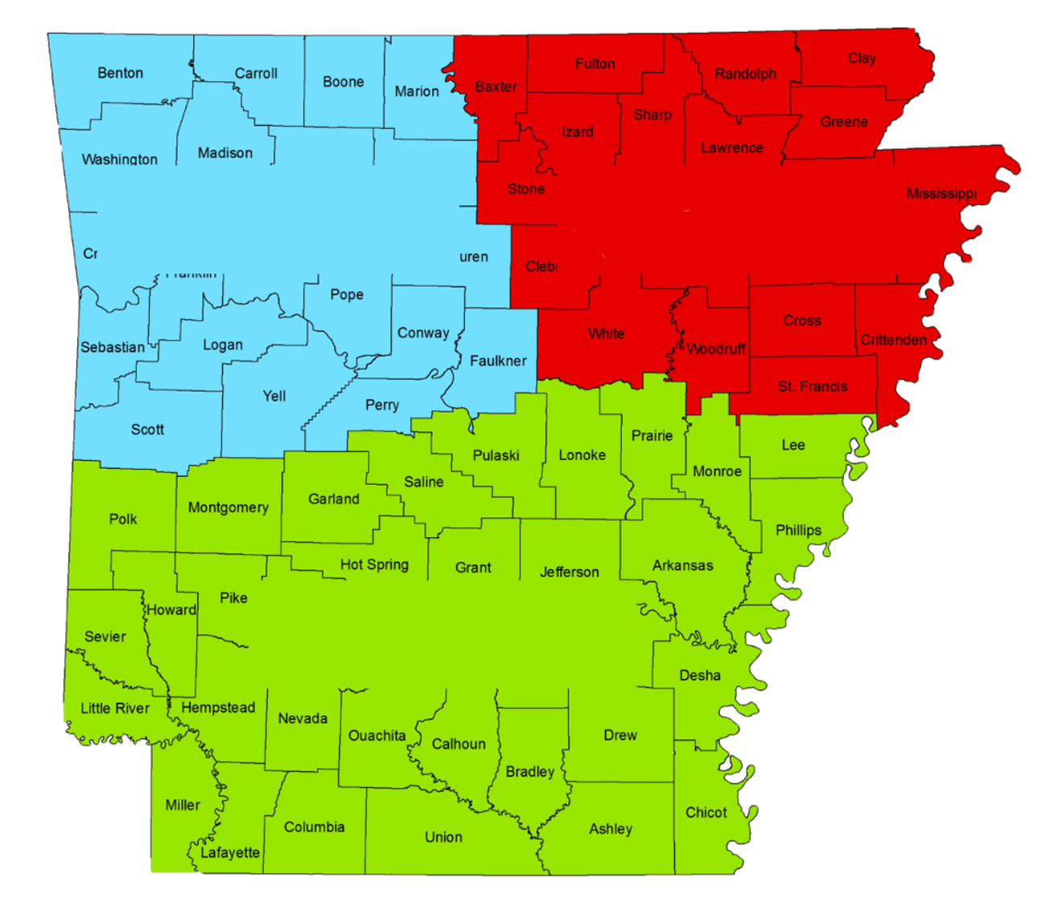
Outdoor Recreation Grants Program www.outdoorgrants.com
Mike Sprague
(501) 682-6947
Randy Roberson
(501) 682-6946
FUN Park Grants
Kristen Dane
(501) 682-1523

Slide 3
How are the grants awarded?
Applicants submit completed application
Applications are scored after submission deadline
Highest-scoring applicants are shortlisted for review (score threshold based upon amount of money available and amount requested, and so varies year to year)
Governor-appointed committee makes funding recommendations (not ORGP staff)

Slide 4
 |  | FUN PARK
ELIGIBLE APPLICANTS |  | Cities with <2,500 population, or, Unincorporated communities ¹
MAX AWARD |  | $100,000
GRANT TYPE |  | No Match
FUNDING |  | Grantee given 100% of grant before project begins
ELIGIBLE PROJECTS |  | Development of most outdoor recreation facilities ²
ENGINEER FEES |  | Up to 12% of development ³
ADMIN FEES |  | Up to 10% of development
¹ Unincorporated communities must be sponsored by county government
² Excludes splash pads, restrooms, concession stands, etc.
³ Engineer required for FUN Park Grant

Slide 5
Frequently Asked FUN Park Questions
How often can I apply for funding?
Each year
How often can I receive funding?
Once every five years
Can funding be used as a match for any other grant?
No.
Must the applicant own the site?
No, it may be leased (25-year min.) Ownership helps, though, points-wise.
Can the funds be used to purchase land?
No.
What procurement guidelines do I follow?
Grantees are responsible for following procurement laws applicable to their local jurisdiction for bidding and purchases.
What accessibility guidelines do I follow?
All grant-funded facilities must be wheelchair accessible and open to the public at all reasonable hours of the day.
Can I change my project after I have received funding?
You may reduce your project’s scope of work, excluding accessibility to remaining work and/or line items for which your application received points. If Fun Park funds remain once the project is completed, contact your Project Officer for possible uses of leftover money.

Slide 6
Required Application Materials
FUN Park Grant
Cover Sheet
Project Narrative
Proof of Land Control
City Council Resolution or Quorum Court Order
Estimated Project Cost

Slide 7
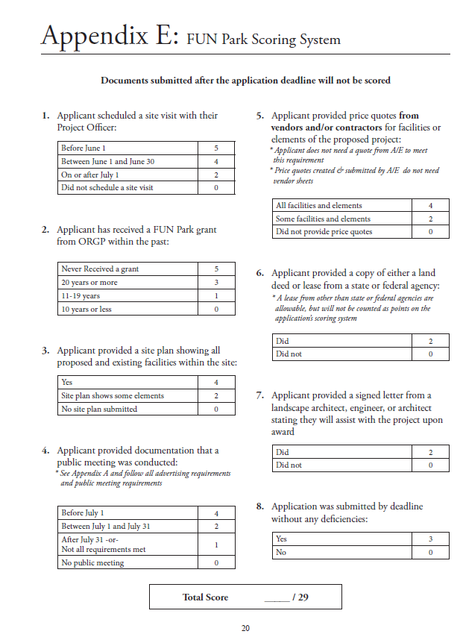

Slide 8
Public Meeting Requirements
Advertising the Meeting
Advertise at least 7 days in advance
Select advertising method
Newspaper
Proof of Publication
Newspaper Clipping
Posted Notice
Copy of Posted Notice
List of Posting Locations
Holding the Meeting
Hold at a time and place convenient for the community
Submit minutes of the meeting
Include statements and suggestions from the general public
Submit a sign-in sheet
Indicate the name, address, and organizational affiliation (if applicable)

Slide 9
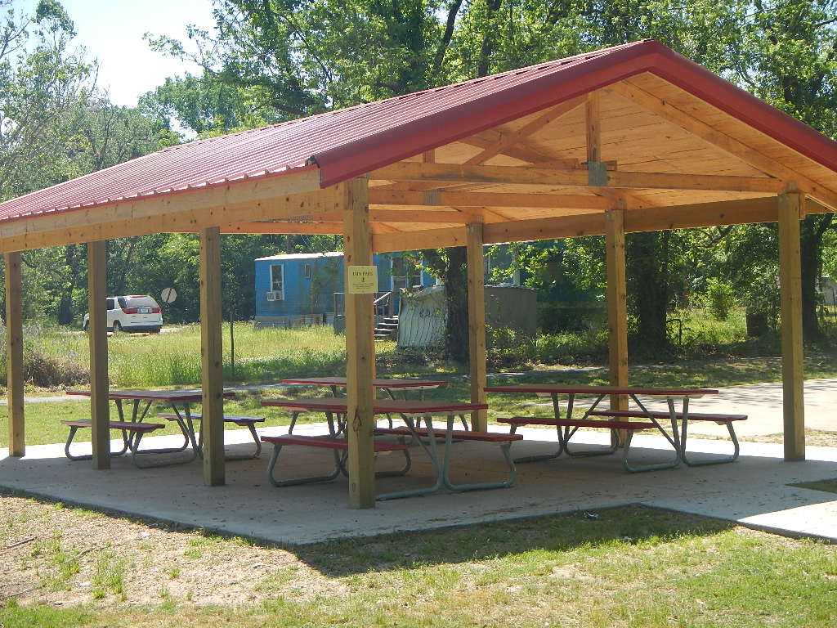
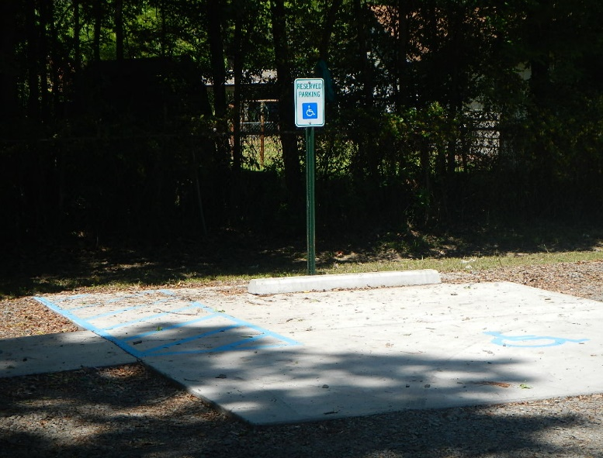
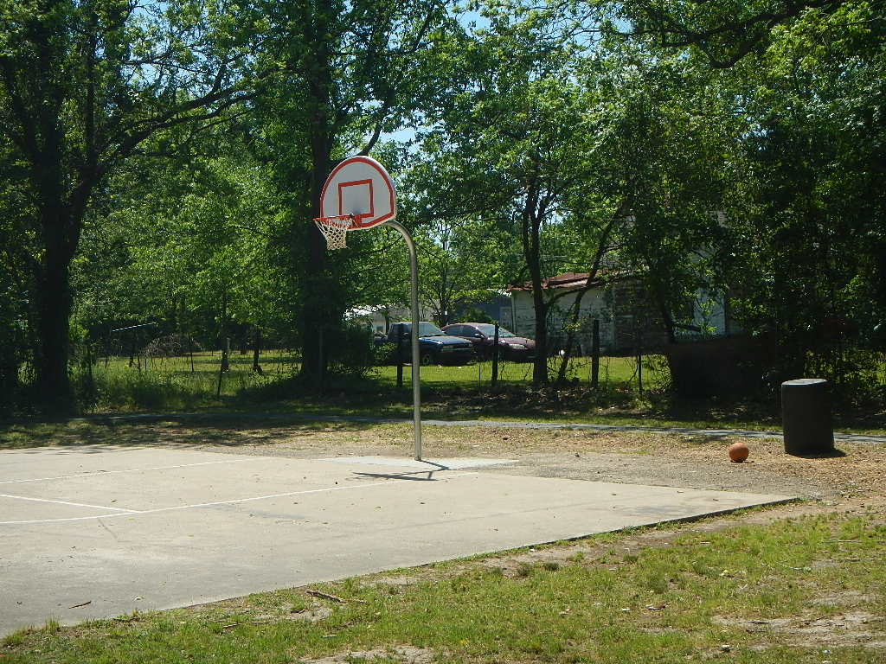
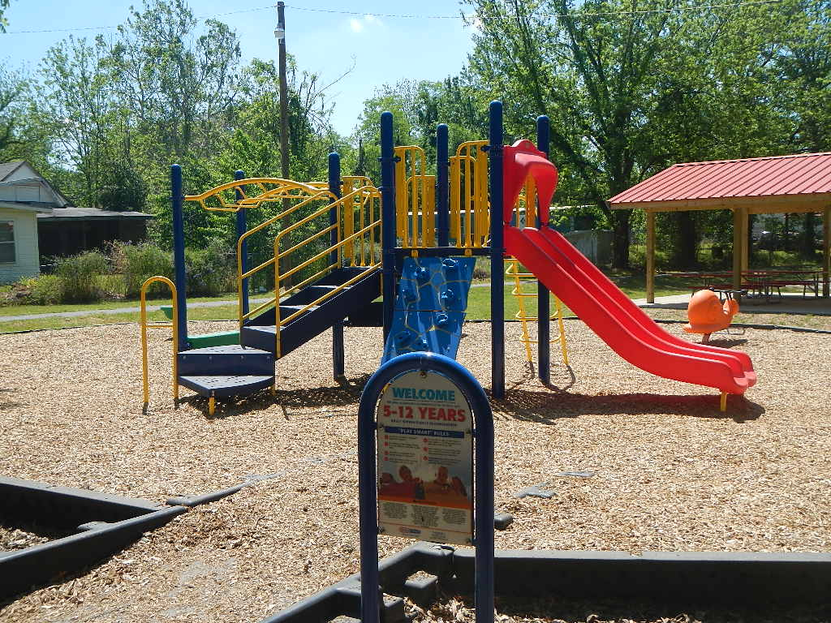
FUN Park Projects

Slide 10
Mike Sprague
(501) 682-6947
Randy Roberson
(501) 682-6946
Kristen Dane
(501) 682-1523

