Slide 1
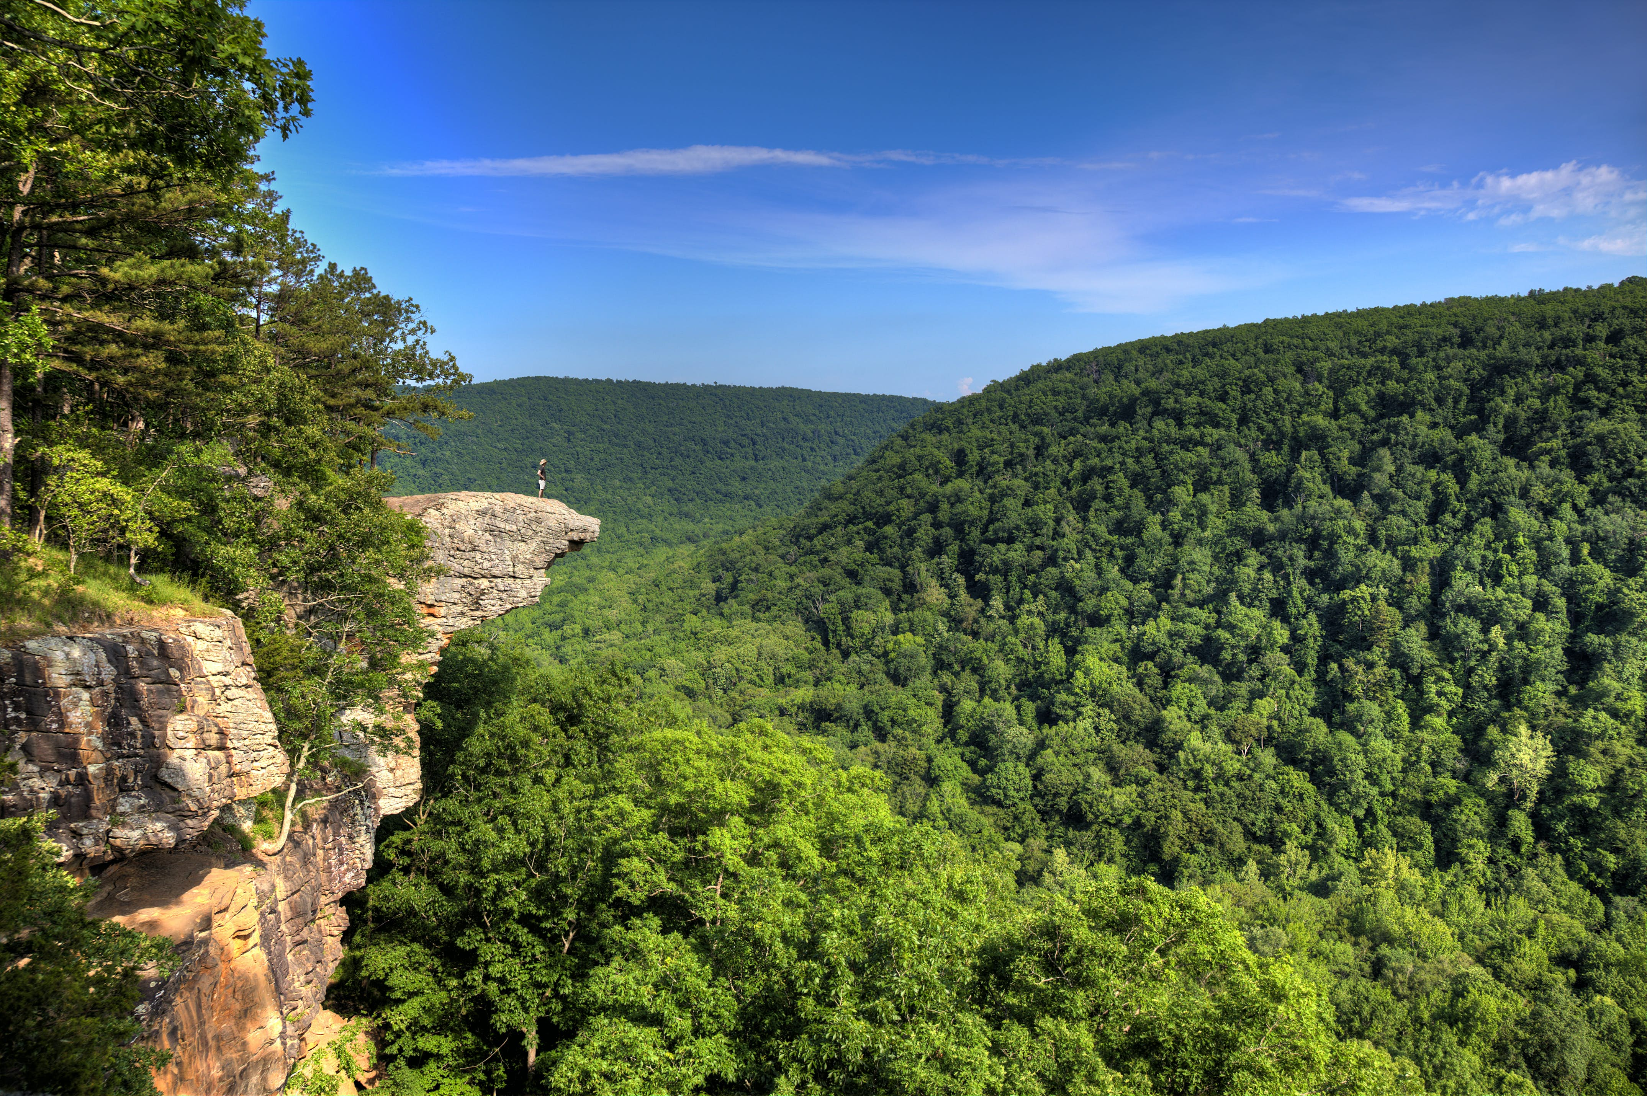
Arkansas Tourism Grants
Notes:
Introduce myself and what I do for tourism (mention regions here)
Name to two tourism grants

Slide 2
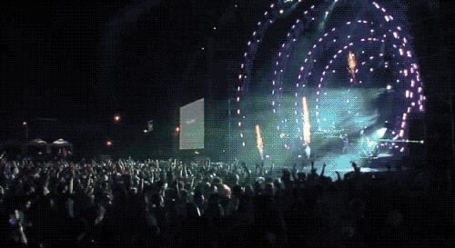
Festival Advertising Grant
Notes:
Photo credit: Susie Cowan

Slide 3
Who may apply?
Incorporated cities/counties with a population of less than 10,500
How much may we apply for?
You may apply for up to $2,000 in reimbursable matching funds
What is covered by the grant?
Advertising expenses only!
– magazine, newspaper, radio, TV, social, flyers, or billboards

Slide 4
Who is NOT eligible?
Cities with a population over 10,500
Chambers of Commerce
Convention and Visitors Bureaus
Universities
Private entities
What is NOT covered?
Anything that is not advertising – festival supplies, clothing, items for resale, vendor contracts, etc.

Slide 5
Application deadline is March 1! Applications are available at the first of the calendar year.
What to include in the application:
Completed official application form
Festival operational budget
Itemized advertising plan
Statement from the minutes, or an administrative order from the governing city or county board, approving the grant request and a statement affirming the amount of funds held by or committed for the purchase of said advertising.

Slide 6
Where to send the application?
Festival Advertising Grant Application
Arkansas Tourism
c/o KateLynn Parks
1 Capitol Mall
Little Rock, AR 72201
The recipients will be notified before or on May 1st.
To receive the grant funds, you must fill out a Request for Payment Form within 30 days of the conclusion of the festival that includes invoices, proof of payment, and proof of performance.

Slide 7
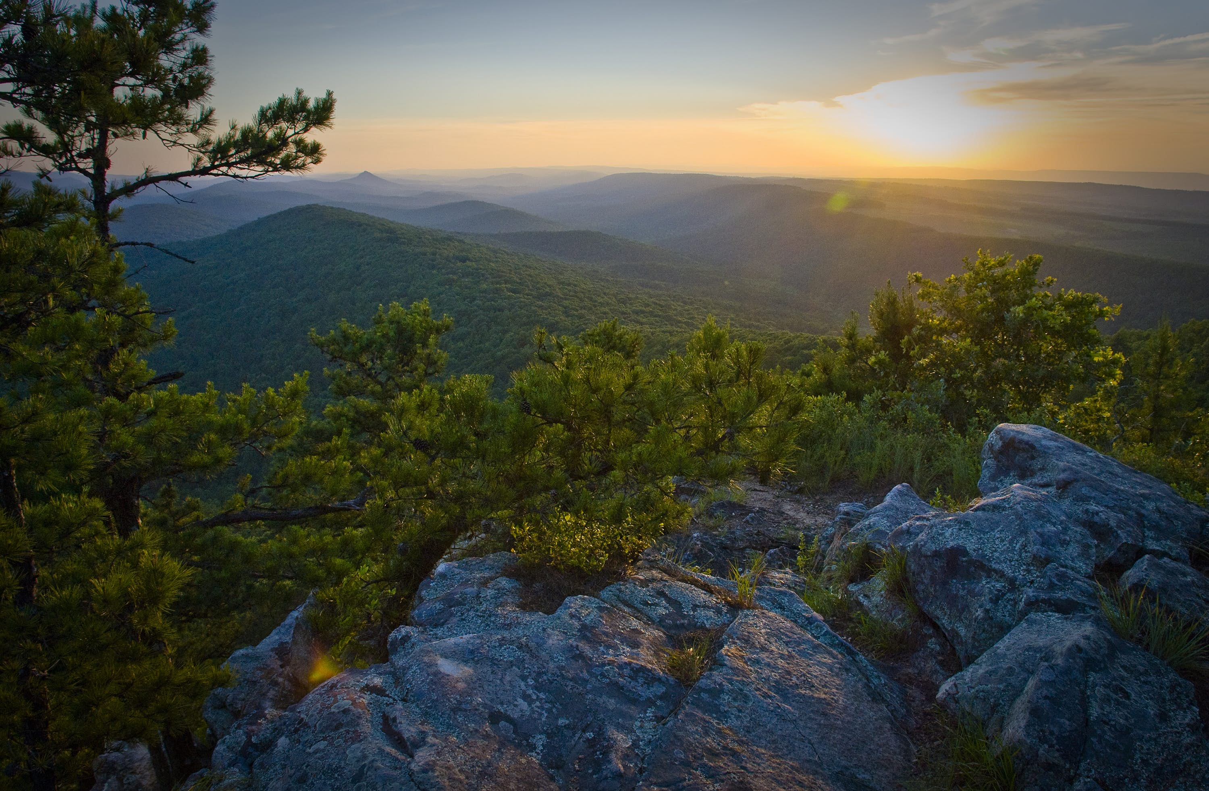
Tourism Attraction Feasibility Study Grant

Slide 8
Who may apply?
Incorporated cities or counties
Unincorporated cities or communities must submit a joint application with the county to apply.
How much may we apply for?
You may apply for up to $15,000 in reimbursable matching funds. Make sure that you can match the funds, or you will be ineligible.
What is covered by the grant?
Only feasibility studies for a tourism attraction can be funded through this grant program.

Slide 9
Potential tourism attractions that qualify for a feasibility study grant:
cultural or historic site
recreational or entertainment facility
area of scenic beauty
theme or amusement park
indoor/outdoor play or music show
botanical gardens
cultural or educational centers
sports complexes
If you are unsure whether your idea qualifies, ask us!

Slide 10
The Feasibility Study must include the following information:
Market area
Projected market support
Demographics
Estimated attendance by tourists
Travel trends
Economic impact, and
A conclusion of whether the project would be feasible or not

Slide 11
Where to send the application?
Feasibility Study Grant Application
Arkansas Tourism
c/o KateLynn Parks
1 Capitol Mall
Little Rock, AR 72201
There are three (3) award periods each fiscal year:
Last Friday in July
Last Friday in September
Last Friday in November
The application can be prepared locally or by consultants.

Slide 12
What to include in the application:
completed official application form
statement of procedures for conducting the study
information on the consultation firm (if applicable)
Statement from the minutes or an administrative order from the governing city or county board approving the grant request and a statement affirming the amount of funds held by or committed for the purchase of said advertising.
Applicants will be notified within 15 days of the application due date per award period. All studies must be completed within 4 months of being awarded the grant.

Slide 13
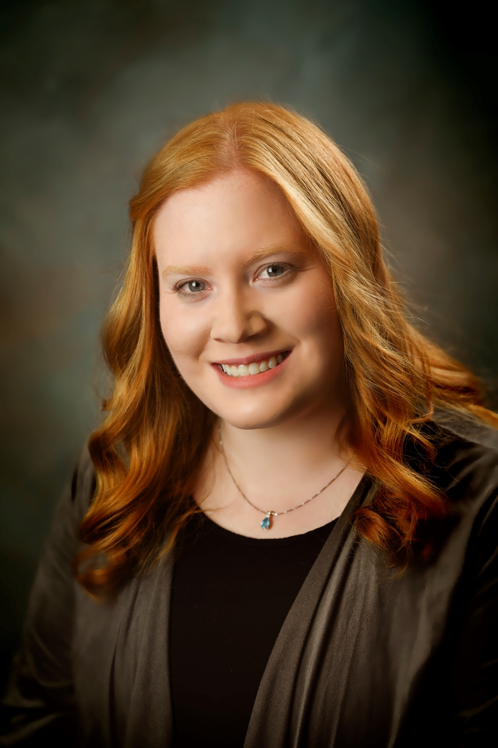
Please contact me with any questions on these tourism grant opportunities:
https://www.arkansas.com/industry-insider/grants
KateLynn Parks
Tourism Development Consultant
Division of Arkansas Tourism
1 Capitol Mall
Little Rock, AR 72201
katelynn.parks@arkansas.gov
office: 501.682.1676
cell: 501.680.3266
Notes:
Say I will hang around after the program with business cards and to answer any questions

