Slide 1
Grants and Programs for Creatives

Slide 2
Mission Statement
The Arkansas Arts Council will advance and empower the arts for the benefit of all Arkansans.
Vision Statement:

Slide 3
Grant Programs
Operational Support General Operating Support
Arts In Education
In-School Residencies
After-School/Summer Residencies
Arts Curriculum Projects
AIE Mini-Grants
Arts for Life-Long Learning
Program Support
Collaborative Project Support
Arts on Tour
Individual Artist Fellowships
Sally A. Williams Artist Fund

Slide 4
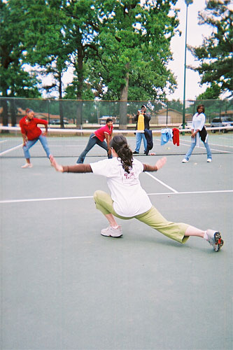
Arts in Education Mini Grants
The AIE Mini-Grants program allows schools /community organizations to fund artist residencies that bring quality, professional artists into the classroom, or after-school and summer programs, to present one-day to ten-day hands-on, curriculum-based, or character-centered arts activities.
Artists must be selected from the Arkansas AIE Artist Roster.

Slide 5
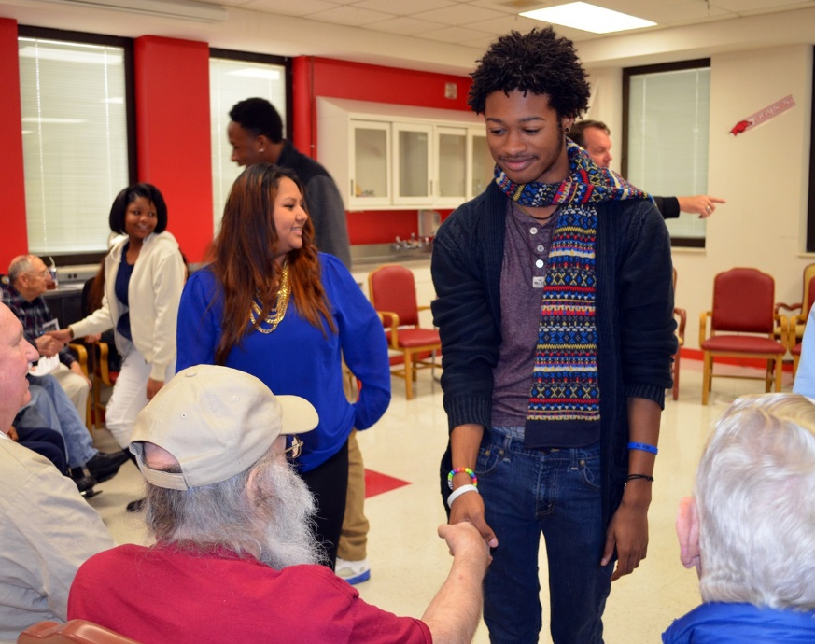
Arts for Lifelong Learning Mini Grants
Allows short-term residencies of up to 10 days where professional artists listed on the AIE roster provide hands-on arts activities for adult populations in community-based or governmental organizations and institutions.
An in-service workshop may also be included in the mini-residency program.
Veterans’ Grants do not need roster artists for program.

Slide 6
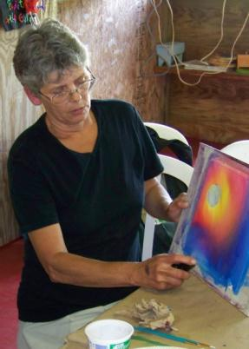
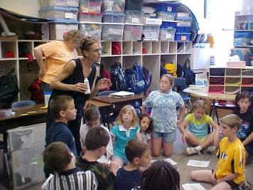
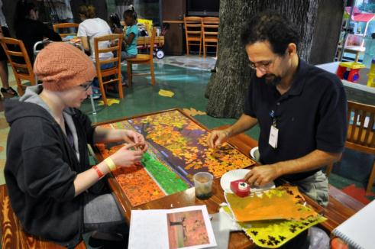
Arts in Education In-School Residency Grants
Grant funds may be used to place professional artists in residencies during the school day or school year at specific school sites or in conjunction with other non-profit community or governmental organizations and institutions.
The AIE-ISR program provides a way for artists to share their art form and relate it to other pre-K – 12 curriculum areas. AIE Roster artists must be teaching artists for residency.

Slide 7
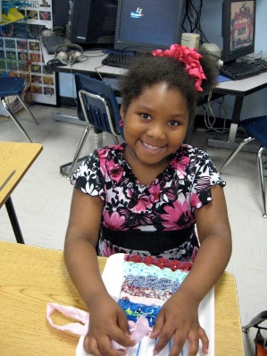
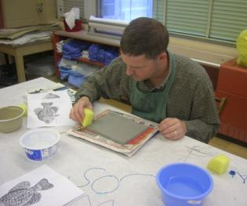
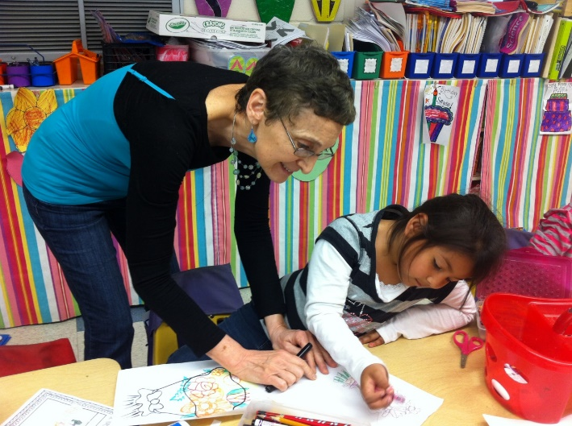
Arts in Education After-School/Summer Residency Grants
Grant funds may be used to place professional artists in AIE residencies outside the school environment.
Settings can be after-school or summer programs located in community/neighborhood centers, low-income housing projects, juvenile facilities, social service centers, recreation programs, boys and girls clubs, or other community-based organizations providing facilities and guidance during non-school hours. AIE Roster artists must be used for program.

Slide 8
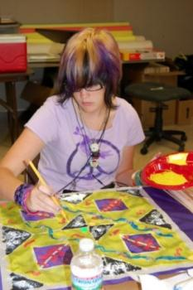
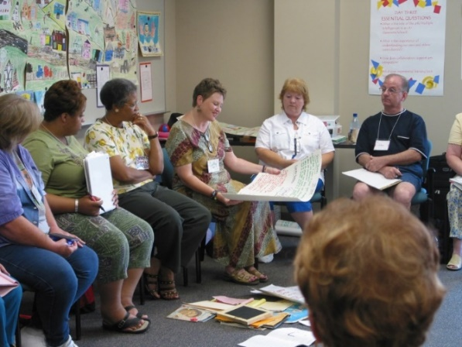
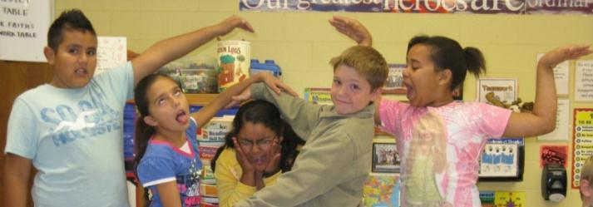
Arts in Education Arts Curriculum Project Grants
Grant funds may be used for projects that foster the arts in basic school curricula. Activities must serve pre-K – 12 students, adult and/or special constituents.
Applicants may also use AIE specialist consultants who are not on the AIE roster.

Slide 9
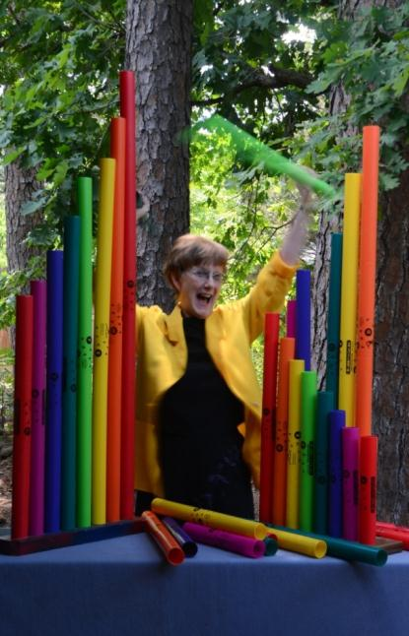
Arts in Education Artist Roster
An online listing of professional artists accepted for AIE residencies after an independent panel review process.
AIE grant applicants coordinate projects with selected AIE Roster artists.
The AIE Artist Roster is available on Arkansas Arts Council website under “Registry and Rosters.”

Slide 10
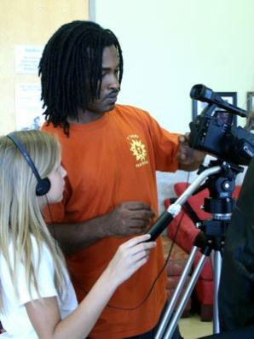
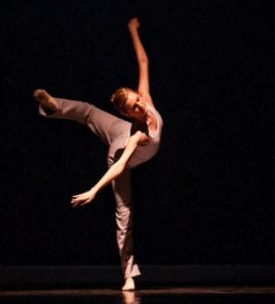
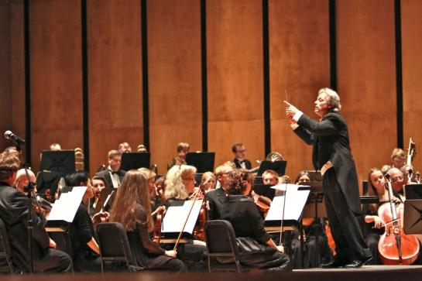
General Operating Support
Designed for established, professionally managed 501(c)(3) arts organizations with annual budgets between $50,000 and $999,999.
Funds must be spent for non-program activities, including salaries of administrative staff, rent, utilities, maintenance of facilities, staff travel and other expenses associated with the operations of the organization.

Slide 11
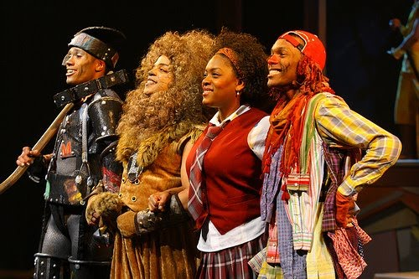
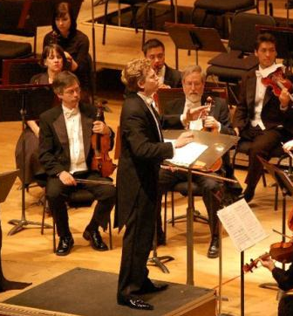
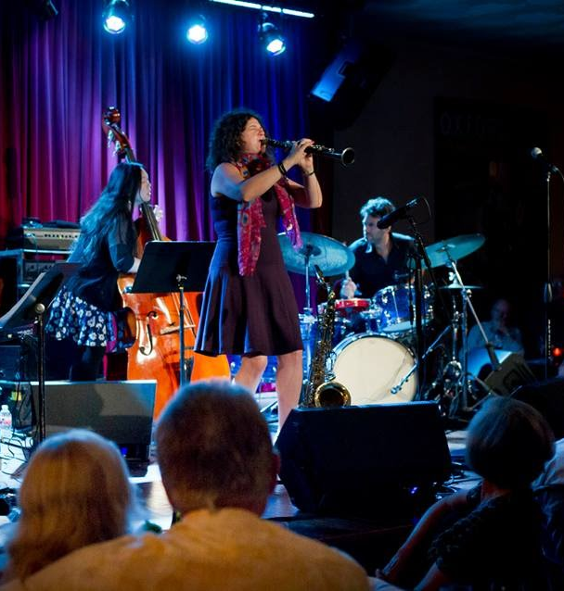
Major Arts Partners
This grant program is designed for eligible 501(c)(3) arts organizations with a three-year budget average equal to or greater than $1 million.
The MAP program is divided into two major grant categories: MAP General Operating Support and MAP Arts in Education.

Slide 12
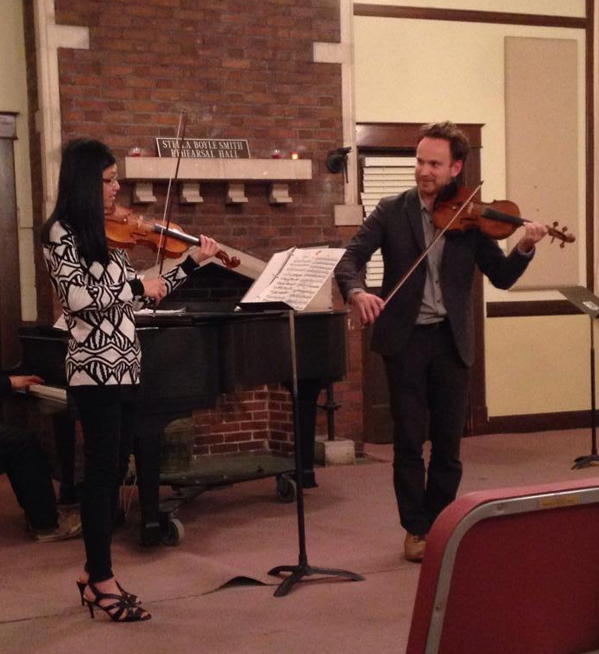
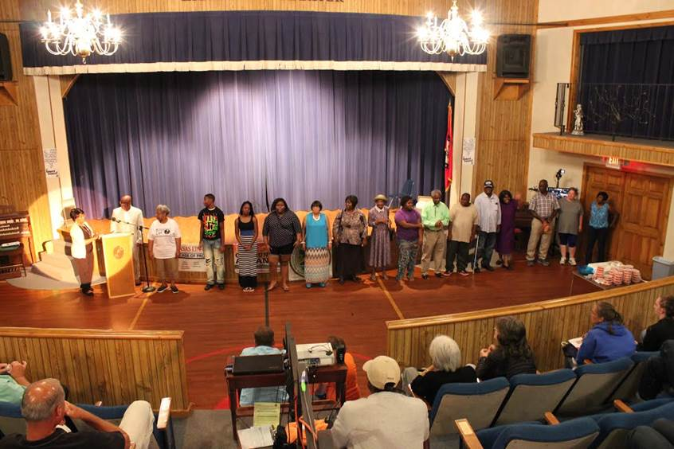
Collaborative Project Support
Collaborative Project Support (CPS) grants up to $10,000 are awarded to 501(c)(3) tax exempt organizations to assist with contracted costs of arts projects involving some form of community outreach.
The proposed project must involve a collaboration between a nonprofit organization and another agency, organization or business.

Slide 13
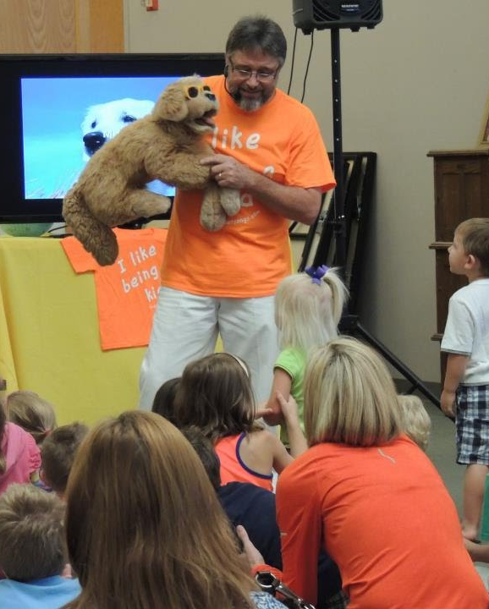
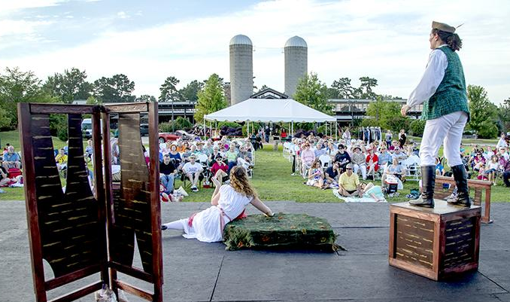
Arts on Tour: Presenter Grants
AOT grants reimburse presenter contract expenses for performances and exhibitions by professional artists listed in the AOT roster.
Only certified not-for-profit organizations may apply.
Reimbursements pay for 40% of AOT roster artist fees up to $2,000.

Slide 14
Arts on Tour Artist Roster
An online listing of professional artists available to perform or exhibit through the AOT program.
Participation in the AOT Roster is by application that is reviewed by an independent panel for inclusion in the program.
The AOT roster is available on the Arkansas Arts Council website under “Registry and Rosters.”
www.arkansasarts.org

Slide 15
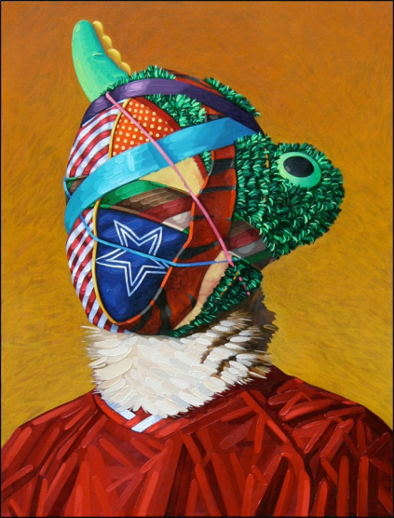
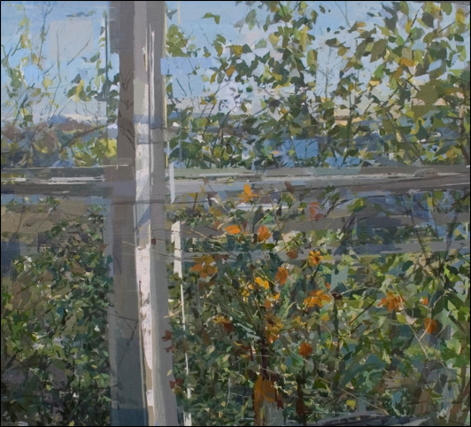
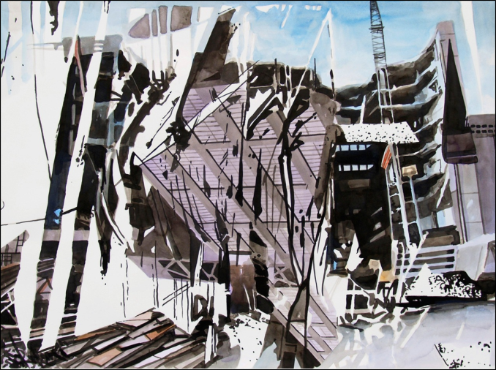
Individual Artist Fellowships
Unconditional awards of $5,000 each for creatives living and working in Arkansas.
Applicants must be residents of Arkansas for at least one year and be 21 years of age at the time of application. Applicants cannot be previous recipients of an Arkansas Arts Council Individual Artist Fellowship Award.
APPLY BY APRIL 14, 2023 AT ARKANSASARTS.ORG

Slide 16
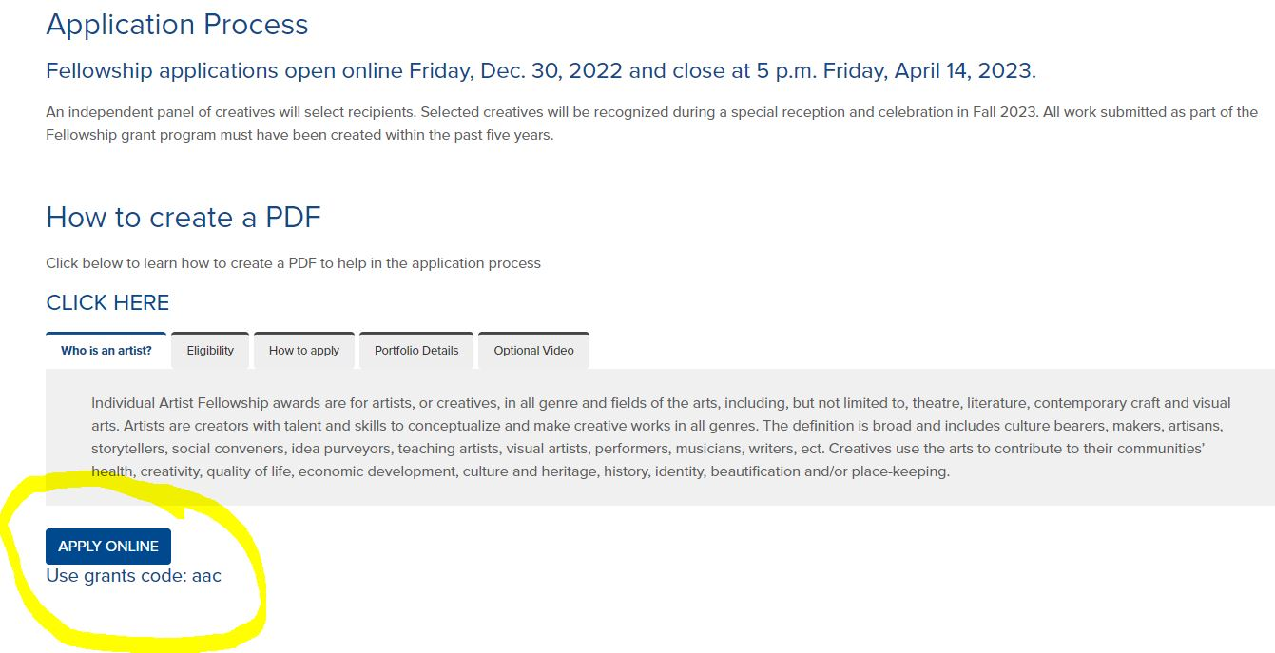
Individual Artist Fellowships

Slide 17
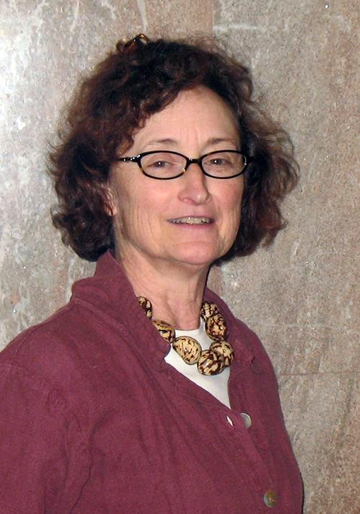
Sally A. Williams Artist Fund
The Sally A. Williams Artist Fund was established in memory of Sally Williams, who served as the AAC’s artist services manager for 25 years before her passing in 2010. Artist assistance grants up to $500 are available to Arkansas creatives in the literary, performing and visual arts.
During FY19, the fund provided more than $7,000 in grants to individuals and $10,000 to organizations hosting Artist Inc. programs for creatives.

Slide 18
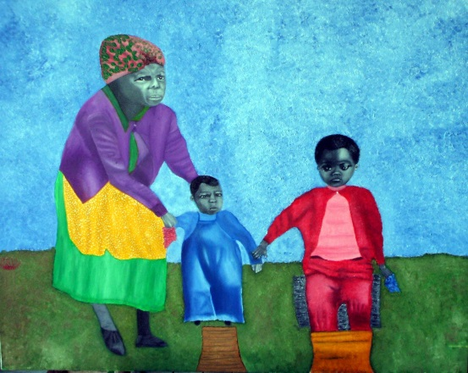
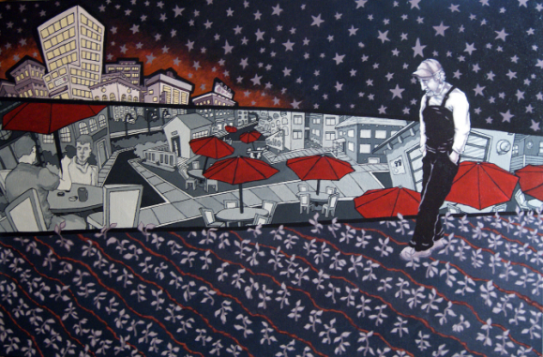
Arkansas Artist Registry
The Registry gives visual artists a virtual platform to showcase their works for free. Registration is required to submit for Small Works on Paper.
Applications are submitted online.

Slide 19
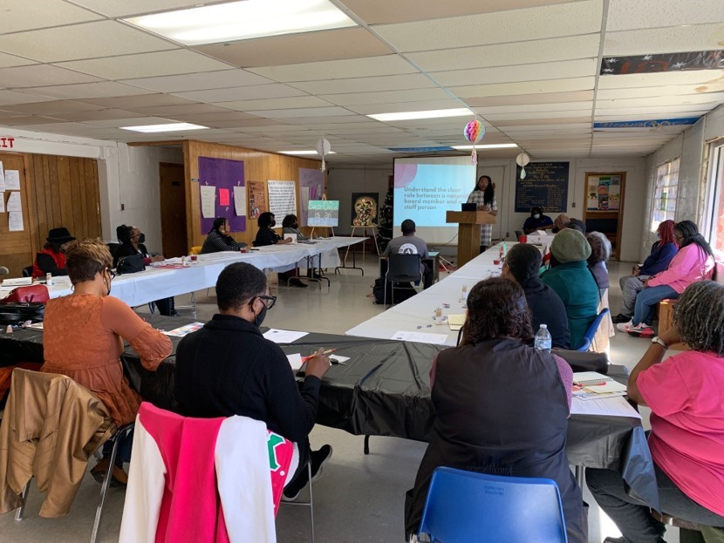
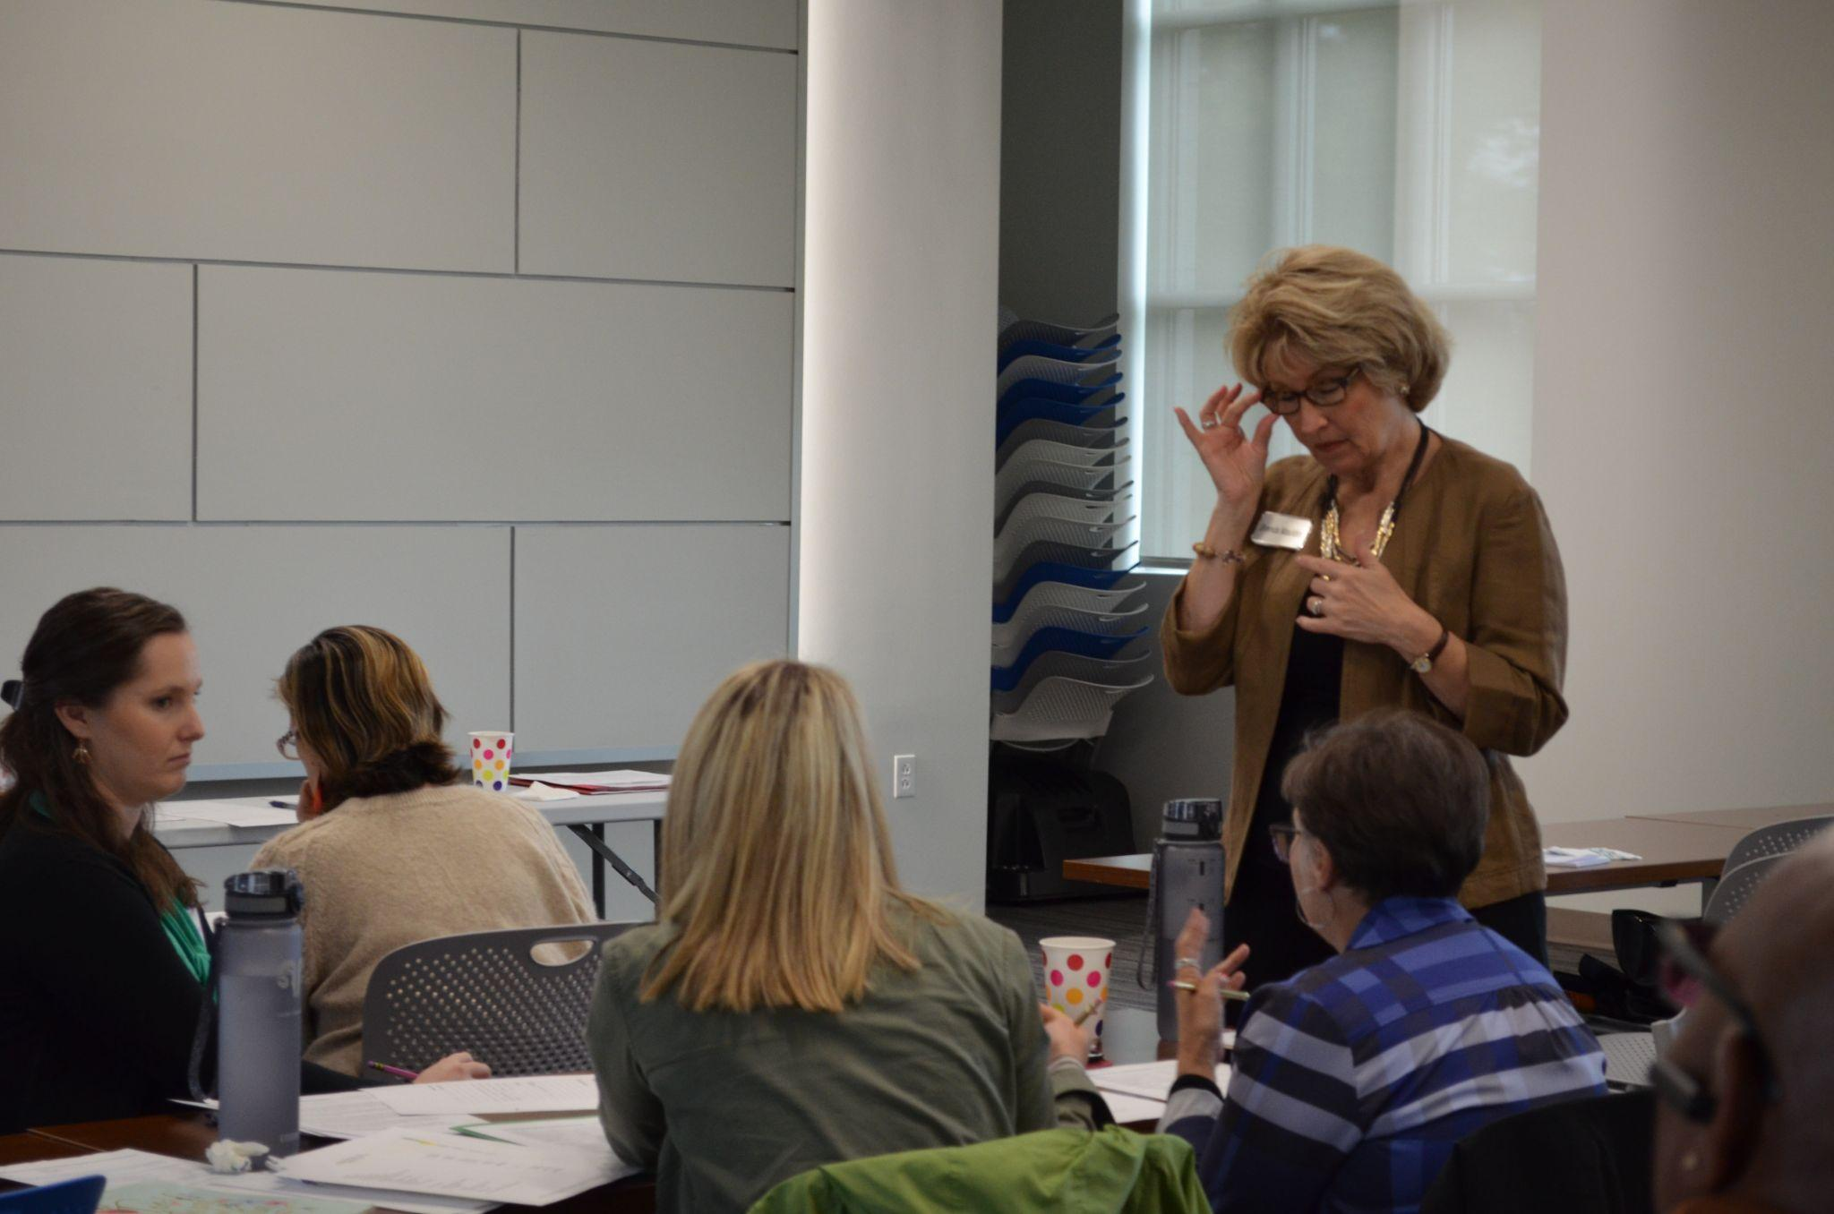

Slide 20
1100 North Street Little Rock, AR 72201 Phone: 501-324-9150
www.arkansasarts.org

